Slide 1
Nu-2000 흡광율 보정재
Creativity & Confidence
www.atikorea.com

Slide 2
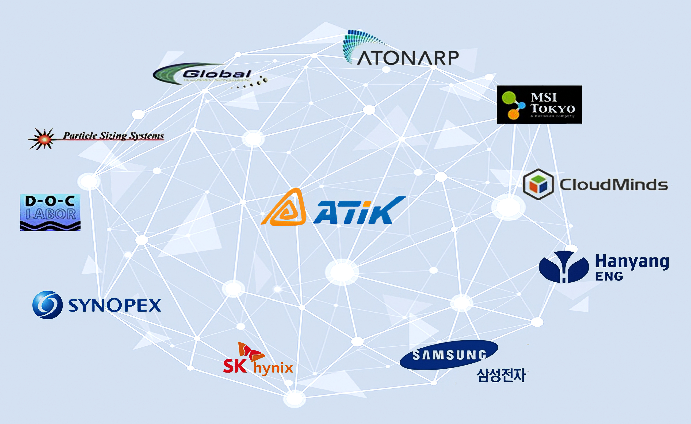
Contents
ATIK 연구소 소개
01
조직도 및 개발역량
02
개발 Project 소개
03
개발 road map
04

Slide 3
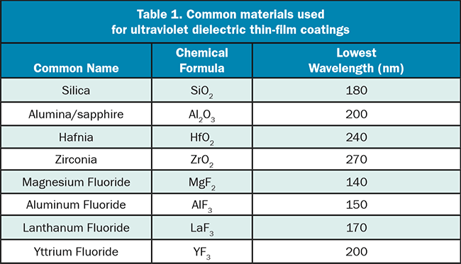
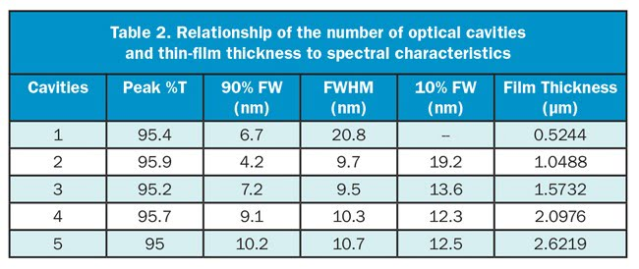
Ultraviolet Filters (Past and Present)
Ultraviolet Filters: Past and Present (https://www.photonics.com/Articles/Ultraviolet_Filters_Past_and_Present/a25446)
ROBERT L. JOHNSON, D.SC. AND SARAH LOCKNAR, PHD, OMEGA OPTICAL INC.
In their earliest forms, UV bandpass filters that were optimized for wavelengths less than 400 nm, such as the Schott UG or the Hoya U-series, were constructed of absorbing compounds in glass. Such filters were limited by the available compounds that can be dissolved or suspended in glass, and they typically had a gradual transition from low to high absorption (Figure 1). These properties in turn limited the applications to ones that do not require sharp or user-defined transitions between transmission and blocking. These limitations were overcome with the development of interference filters, which were made by depositing a multilayer optical coating onto one or more transparent substrates, thus producing a more refined transmission band surrounded by regions of low transmission (the blocking region).

Slide 4
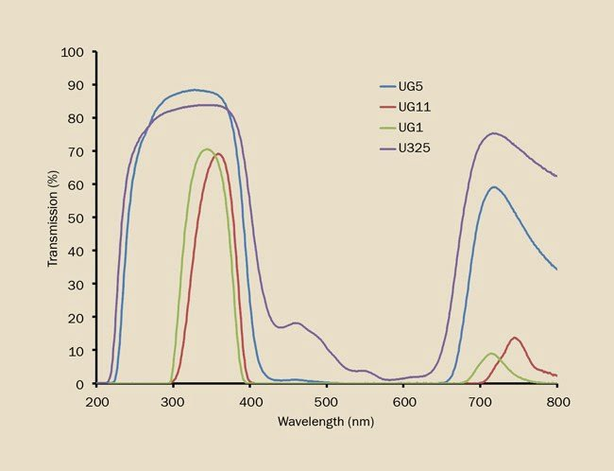
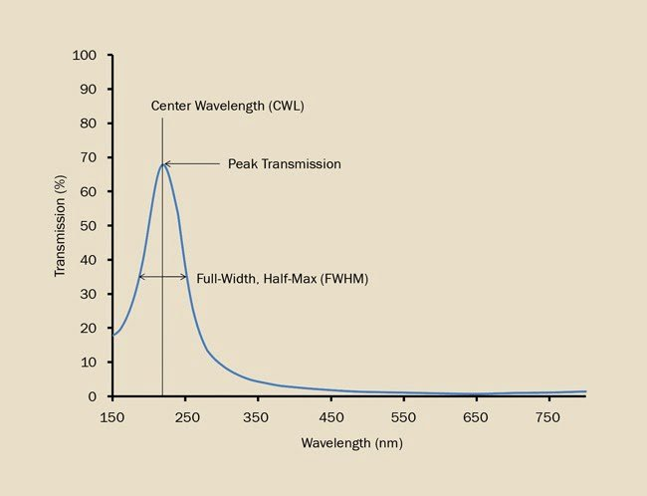
Ultraviolet Filters (Past and Present)
Ultraviolet Filters: Past and Present (https://www.photonics.com/Articles/Ultraviolet_Filters_Past_and_Present/a25446)
Figure 1. UV transmitting glasses are designed to transmit some UV wavelengths while absorbing the bulk of the light in the visible wavelengths.
Figure 2. An induced-transparency filter with three layers in an MDM arrangement.

Slide 5
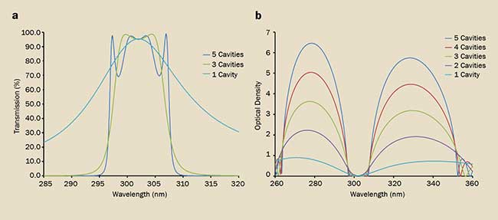
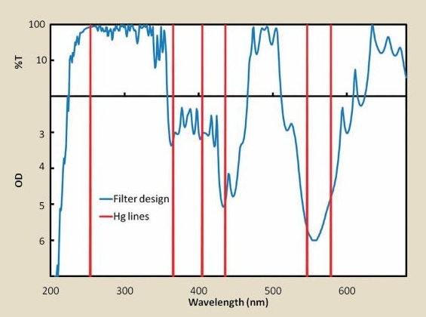
Ultraviolet Filters (Past and Present)
Ultraviolet Filters: Past and Present (https://www.photonics.com/Articles/Ultraviolet_Filters_Past_and_Present/a25446)
Figure 3. Dielectric filters with an increasing number of cavities in the simple FP design. Peak %T is not significantly affected by an increase in the number of cavities (a), but blocking and edge steepness of the bandpass increases with the number of cavities (b).
Figure 4. A dielectric filter designed to transmit the Hg line at 253.7 nm while blocking other spectral lines.

Slide 6
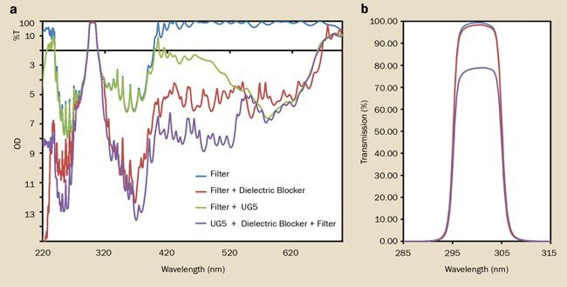
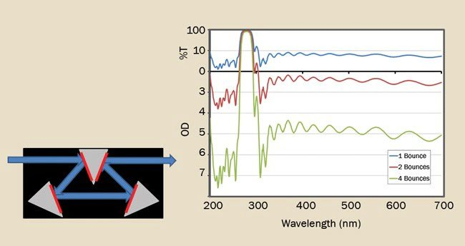
Ultraviolet Filters (Past and Present)
Ultraviolet Filters: Past and Present (https://www.photonics.com/Articles/Ultraviolet_Filters_Past_and_Present/a25446)
Figure 5. Different blocking strategies for a 300-nm dielectric bandpass filter (a) and the effect on %T (b).
Figure 6. A multi-bounce reflected filter assembly at 22.5° angle of incidence.

Slide 7
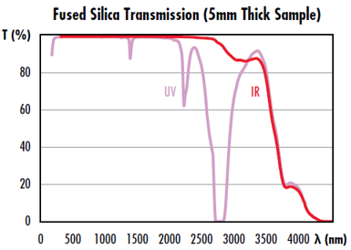
UV vs. IR Grade Fused Silica
https://www.edmundoptics.co.kr/knowledge-center/application-notes/optics/uv-vs.-ir-grade-fused-silica/
Fused silica : a common glass type for lenses, windows, mirrors, prisms, and beamsplitters.
Fused silica : consistent and repeatable optical performance.¹ a low thermal expansion coefficient that provides high thermal stability and resistance to thermal shocks, Fused silica : a high chemical resistance and minimal fluorescence. UV grade fused silica and IR grade fused silica.
UV grade fused silica is manufactured synthetically through the oxidation of high purity silicon by flame hydrolysis.² The UV grade : high transmittance in the UV spectrum, but there are dips in transmission centered at 1.4µm, 2.2µm, and 2.7µm due to absorption from hydroxide (OH-) ion impurities.
IR grade fused silica differs from UV grade fused silica by its reduced amount of OH- ions, resulting in higher transmission throughout the NIR spectrum and reduction of transmission in the UV spectrum (Figure 1). OH- ions can be reduced by melting high-quality quartz or using special manufacturing techniques.³
Developments in lasers with wavelengths around 2µm, including thulium (2080nm) and holmium (2100nm), have led to many more applications utilizing lasers in the 2µm wavelength region. 2µm is close to one of the OH- absorption peaks in UV grade fused silica, making IR grade fused silica a much better option for 2µm applications. The high absorption of UV grade used silica around 2µm will lead to heat generation and potentially cause damage. However, IR grade fused silica optical components often have a higher cost and lower availability.
Understanding your application’s wavelength range is important for selecting the appropriate substrate. Edmund Optics® offers select optical components with IR grade fused silica (Corning 7979) and UV grade fused silica (Corning 7980) substrate options. For assistance in selecting the correct fused silica product for your application, please contact our free engineering support.
Figure 1: Transmission data for UV and IR grade fused silica for a 5mm thick sample without Fresnel reflections¹

Slide 8
Edmund Optics 문의
https://www.edmundoptics.co.kr/contact-support/
가장 가까운 EO 지역 사무실 중 한 곳으로 연락하십시오. 다음 프로젝트를 성공적으로 이끌어 드리겠습니다!
82-2-769-4600
문의 내용:
아래의 파장에 대해 일정한 투과율 (예: 30%, 50%, 70%, ....) 을 갖는 광학 부품 (필터 유사 부품) 을 찾고 있습니다.
275nm, 2250nm 각각에 대해 적용할 수 있는 별개의 부품들 (2가지)이 있다면 제품 모델명을 알려 주세요.
원하는 기능은 275nm (또는 2250nm) 광원에 대해 일정한 투과율을 보장해주는 보정용 부품을 찾는 것입니다.
확인 요청 드립니다. 감사합니다.
업체 답변:
자사에서 취급하고 있는 Bandpass filter, 표준제품으로 제품 조회 시,
CWL 275 nm 는 없으며, CWL 270 nm, FWHM 10 nm 는 보유하고 있으며, CWL 2250 nm 에 대해서는 보유하고 있지 않습니다.
CWL 270 nm, FWHW 10 nm, Dia.12.5 mm : 35873
첨부된 링크 내에서 제품 상세 사양 검토 부탁드리겠습니다.

Slide 9
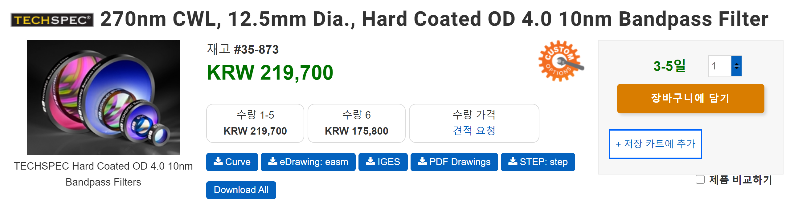
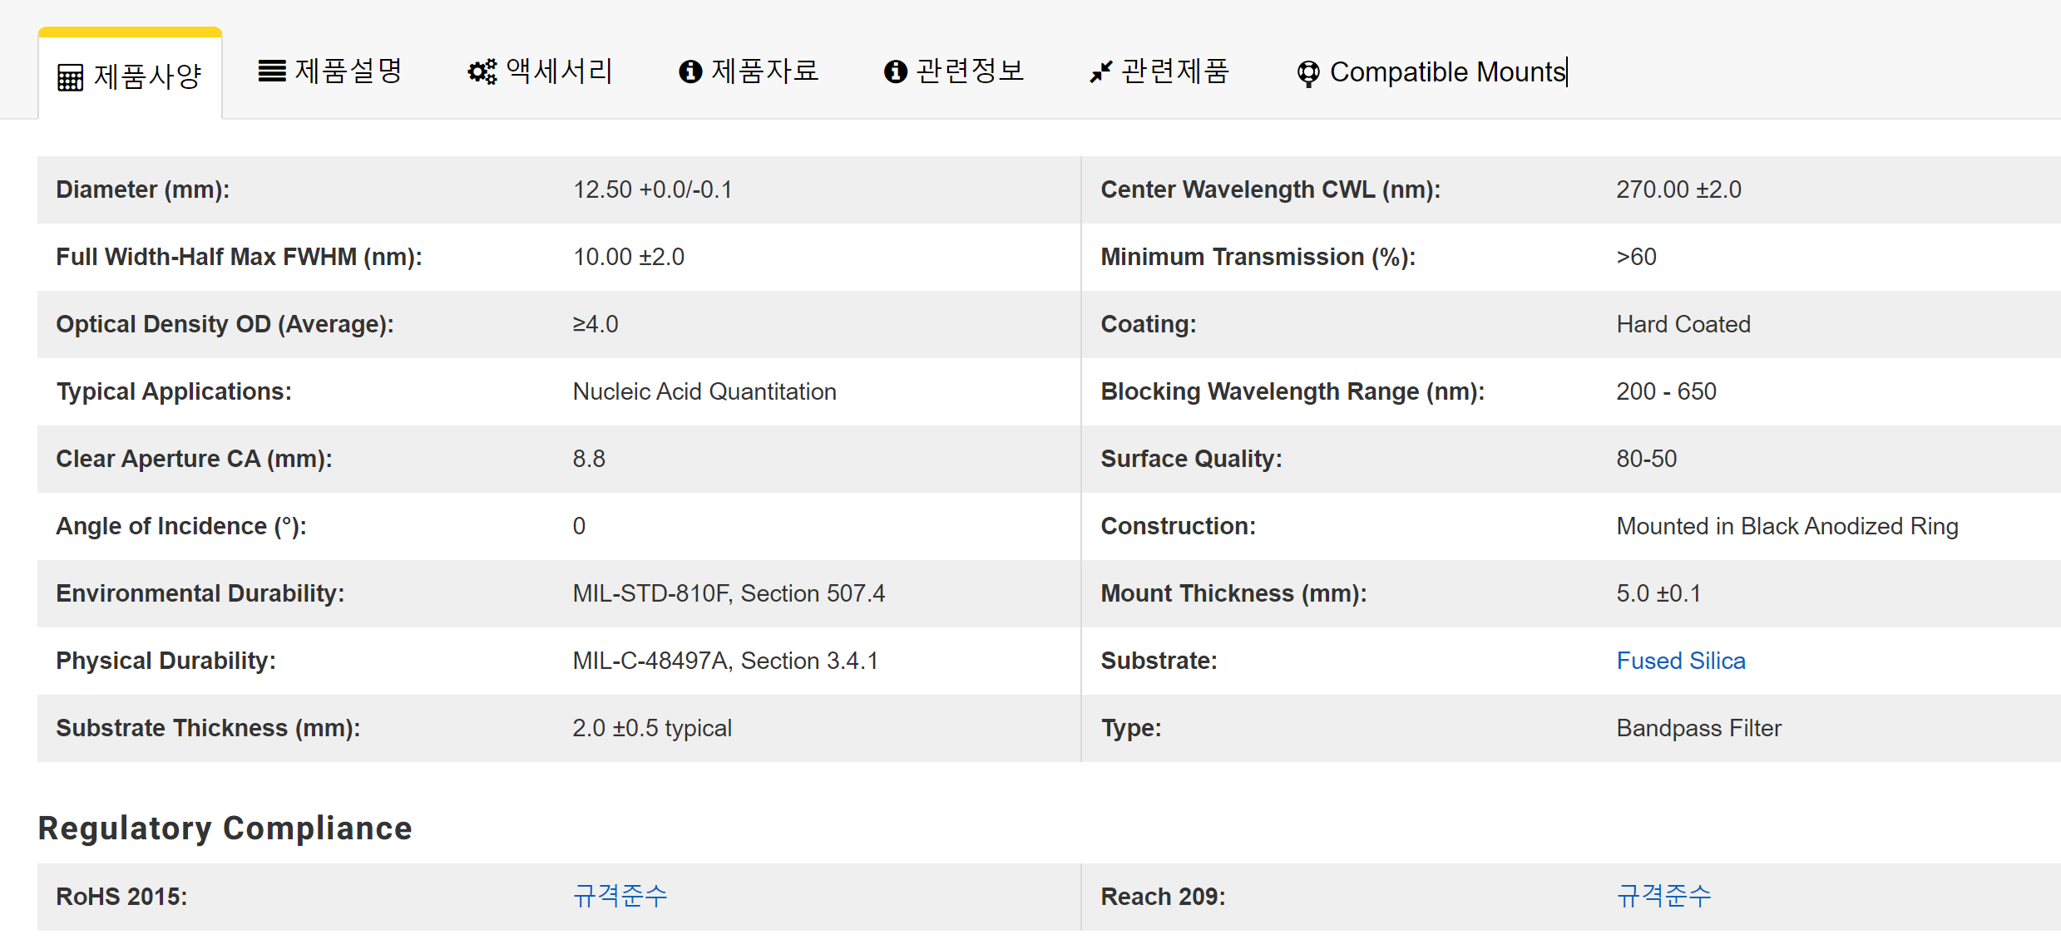
Edmund Optics, Bandpass Filter (270nm CWL)
https://www.edmundoptics.co.kr/p/270nm-cwl-125mm-dia-hard-coated-od-4-10nm-bandpass-filter/33366/

Slide 10
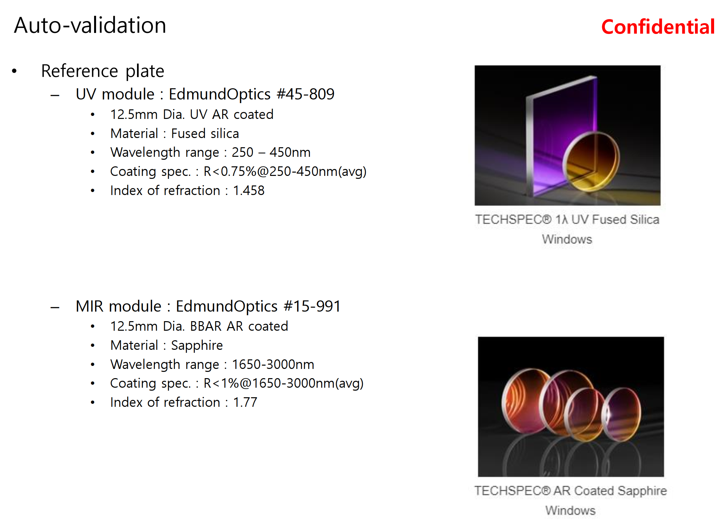

Slide 11
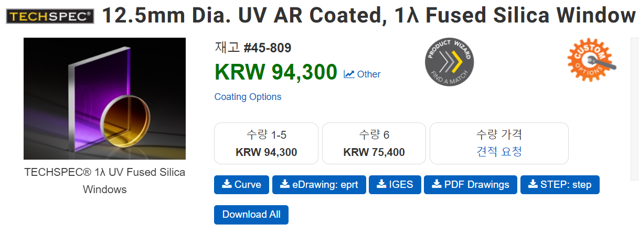
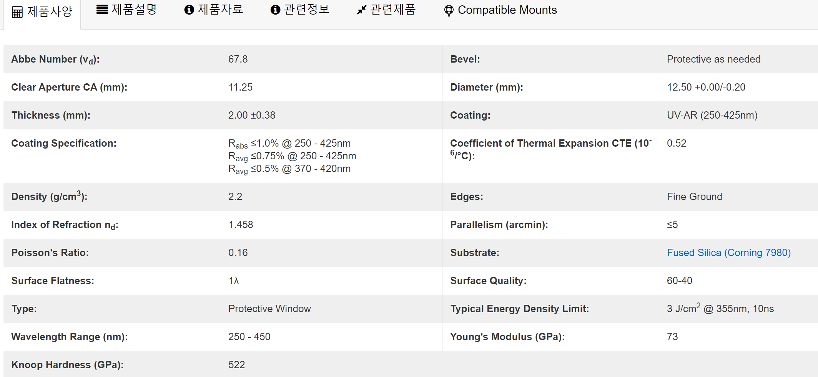
https://www.edmundoptics.co.kr/p/125mm-dia-uv-ar-coated-1lambda-fused-silica-window/6257/

Slide 12
감사합니다
Creativity & Confidence
www.atikorea.com

